Slide 1
Quality Attributes and Measurement
CSE 4495 - Lecture 2 - 22/10/2022

Slide 2
Today’s Goals
Discuss software quality in more detail.
Dependability, availability, performance, scalability, and security.
How we build evidence that the system is good enough to release.
How to assess whether each attribute is met.

Slide 3
Quality Attributes
Describe desired properties of the system.
Developers prioritize attributes and design system that meets chosen thresholds.
Most relevant for this course: dependability
Ability to consistently offer correct functionality, even under unforeseen or unsafe conditions.

Slide 4
Quality Attributes
Availability
Ability to carry out a task when needed, to minimize “downtime”, and to recover from failures.
Modifiability
Ability to enhance software by fixing issues, adding features, and adapting to new environments.
Testability
Ability to easily identify faults in a system.
Probability that a fault will result in a visible failure.

Slide 5
Quality Attributes
Performance
Ability to meet timing requirements. When events occur, the system must respond quickly.
Security
Ability to protect information from unauthorized access while providing service to authorized users.
Scalability
Ability to “grow” the system to process more concurrent requests.

Slide 6
Quality Attributes
Interoperability
Ability to exchange information with and provide functionality to other systems.
Usability
Ability to enable users to perform tasks and provide support to users.
How easy it is to use the system, learn features, adapt to
meet user needs, and increase confidence and satisfaction in usage.

Slide 7
Quality Attributes
Resilience
Supportability
Portability
Development Efficiency
Time to Deliver
Tool Support
Geographic Distribution

Slide 8
Quality Attributes
Quality Attributes
These qualities often conflict.
Fewer subsystems improves performance, but hurts modifiability.
Redundant data helps availability, but lessens security.
Localizing safety-critical features ensures safety, but degrades performance.
Important to decide what is important, and set a threshold on when it is “good enough”.

Slide 9
Our Focus
Quality Attributes
Dependability
Availability
Performance
Scalability
Security
(Others important - but not enough time for all!)

Slide 10
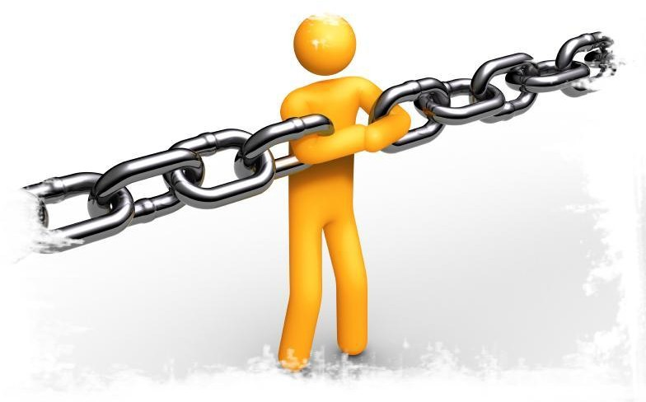
Dependability

Slide 11
When is Software Ready for Release?
When is Software Ready for Release?
Provide evidence that the system is dependable.
The goal of dependability is to establish four things about the system:
That it is correct.
That it is reliable.
That it is safe.
That is is robust.
Reliable Correct
Safe
Robust

Slide 12
Correctness
Correctness
A program is correct if it is always consistent with its specification.
Depends on quality and detail of requirements.
Easy to show with respect to a weak specification.
Often impossible to prove with a detailed specification.
Correctness is rarely provably achieved.

Slide 13
Reliability
Reliability
Statistical approximation of correctness.
The likelihood of correct behavior from some period of observed behavior.
Time period, number of system executions
Measured relative to a specification and usage profile (expected pattern of interaction).
Dependent on how the system is used by a type of user.

Slide 14
Dependence on Specifications
Dependence on Specifications
Correctness and reliability:
Success relative to the strength of the specification.
Hard to meaningfully prove anything for strong spec.
Severity of a failure is not considered.
Some failures are worse than others.
Safety revolves around a restricted specification.
Robustness focuses on everything not specified.

Slide 15
Safety
Safety
Safety is the ability to avoid hazards.
Hazard = defined undesirable situation.
Generally serious problems.
Relies on a specification of hazards.
Defines what the hazard is, how it will be avoided in the software.
We prove or show evidence that the hazard is avoided.
Only concerned with hazards, so proofs often possible.

Slide 16
Robustness
Robustness
Software that is “correct” may fail when the assumptions of its design are violated.
How it fails matters.
Software that “gracefully” fails is robust.
Design the software to counteract unforeseen issues or perform graceful degradation of services.
Look at how a program could fail and handle those situations.
Cannot be proved, but is a goal to aspire to.

Slide 17
Dependability Property Relations
Dependability Property Relations
Reliable, but not correct. Catastrophic failures can occur.
Robust, but not safe. Catastrophic failures can occur.
Reliable
Correct
Safe
Robust
Correct, but not safe. Specification is inadequate
Safe, but not correct. Annoying failures can occur.

Slide 18
Measuring Dependability
Measuring Dependability
Must establish criteria for when the system is dependable enough to release.
Correctness hard to prove conclusively.
Robustness/Safety important, but do not demonstrate functional correctness.
Reliability is the basis for arguing dependability.
Can be measured.
Can be demonstrated through testing.

Slide 19
Let’s take a break!

Slide 20
Measuring Reliability

Slide 21
What is Reliability?
What is Reliability?
Probability of failure-free operation for a specified time in a specified environment for a given purpose.
Depends on system and type of user.
How well users think the system provides services they require.

Slide 22
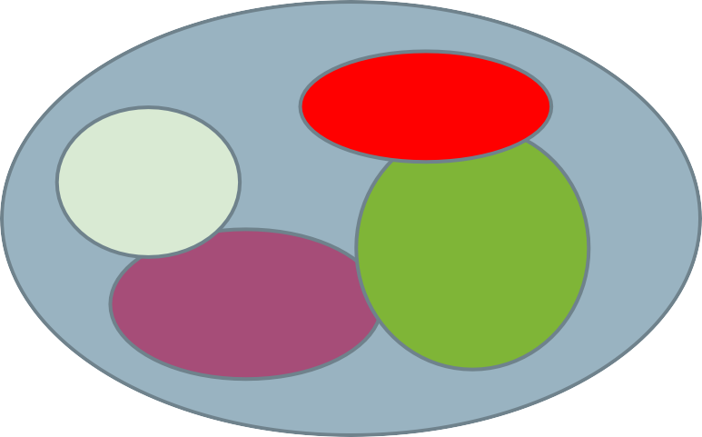
Improving Reliability
Improving Reliability
Improved when faults in the most frequently-used parts of the software are removed.
Removing X% of faults != X% improvement in reliability.
In one study, removing 60%
of faults led to 3% improvement.
Removing faults with serious consequences is the top priority.
Input Causing Failure
User 1
User 3
User 2

Slide 23
Reliability is Measurable
Reliability is Measurable
Reliability can be defined and measured.
Reliability requirements can be specified:
Non-functional requirements define number of failures that are acceptable during normal use or time in which system is allowed to be unavailable.
Functional requirements define how the software avoids, detects, and tolerates failures.

Slide 24
How to Measure Reliability
How to Measure Reliability
Hardware metrics often aren’t suitable for software.
Based on component failures and the need to repair or replace a component once it has failed.
In hardware, the design is assumed to be correct.
Software failures are always design failures.
Often, the system is available even though a failure has occurred.
Metrics consider failure rates, uptime, and time between failures.

Slide 25
Metric 1: Availability
Metric 1: Availability
Can the software carry out a task when needed?
Encompasses reliability and repair.
Does the system tend to show correct behavior?
Can the system recover from an error?
The ability to mask or repair faults such that cumulative outages do not exceed a required value over a time interval.
Both a reliability measurement AND an independent quality attribute.

Slide 26
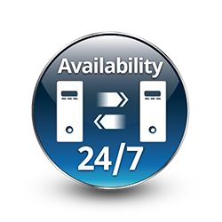
Metric 1: Availability
Metric 1: Availability
Measured as (uptime) / (total time observed)
Takes repair and restart time into account.
Does not consider incorrect computations.
Only considers crashes/freezing.
0.9 = down for 144 minutes a day.
0.99 =14.4 minutes
0.999 = 84 seconds
0.9999 = 8.4 seconds

Slide 27
Availability
Availability
Improvement requires understanding nature of failures that arise.
Failures can be prevented, tolerated, removed, or forecasted.
How are failures detected?
How frequently do failures occur?
What happens when a failure occurs?
How long can the system be out of operation?
When can failures occur safely?
Can failures be prevented?
What notifications are required when failure occurs?

Slide 28
Availability Considerations
Availability Considerations
Time to repair is the time until the failure is no longer observable.
Can be hard to define. Stuxnet caused problems for months. How does that impact availability?
Software can remain partially available more easily than hardware.
If code containing fault is executed, but system is able to recover, there was no failure.

Slide 29
Metric 2: Probability of Failure on Demand (POFOD)
Metric 2: Probability of Failure on Demand (POFOD)
Likelihood that a request will result in a failure
(failures/requests over observed period)
POFOD = 0.001 means that 1 out of 1000 requests fail.
Used in situations where a failure is serious.
Independent of frequency of requests.
1/1000 failure rate sounds risky, but if one failure per lifetime, may be good.

Slide 30
Metric 3: Rate of Occurrence of Fault (ROCOF)
Metric 3: Rate of Occurrence of Fault (ROCOF)
Frequency of occurrence of unexpected behavior.
(number of failures / total time observed)
ROCOF of 0.02 means 2 failures per 100 time units.
Often given as “N failures per M seconds/minutes/hours”
Most appropriate metric when requests are made on a regular basis (such as a shop).

Slide 31
Metric 4: Mean Time Between Failures (MTBF)
Metric 4: Mean Time Between Failures (MTBF)
Average length of time between observed failures.
Only considers time where system operating.
Requires the timestamp of each failure and the timestamp of when the system resumed service.
Used for systems with long user sessions, where crashes can cause major issues.
E.g., saving requires resource (disc/CPU/memory) consumption.

Slide 32
Probabilistic Availability
Probabilistic Availability
(alternate definition)
Probability that system will provide a service within required bounds over a specified time interval.
Availability = MTBF / (MTBF + MTTR)
MTBF: Mean time between failures.
MTTR: Mean time to repair

Slide 33
Reliability Metrics
Reliability Metrics
Availability: (uptime) / (total time observed)
POFOD: (failures/ requests over period)
ROCOF: (failures / total time observed)
MTBF: Average time between observed failures.
MTTR: Average time to recover from failure.

Slide 34
Reliability Examples
Reliability Examples
Provide software with 10000 requests.
Wrong result on 35 requests, crash on 5 requests.
What is the POFOD?
Run the software for 144 hours
(6 million requests). Software failed on 6 requests.
What is the ROCOF? The POFOD?

Slide 35
Reliability Examples
Reliability Examples
Provide software with 10000 requests.
Wrong result on 35 requests, crash on 5 requests.
What is the POFOD?
40 / 10000 = 0.0004
Run the software for 144 hours
(6 million requests). Software failed on 6 requests.
What is the ROCOF? The POFOD?

Slide 36
Reliability Examples
Reliability Examples
Provide software with 10000 requests.
Wrong result on 35 requests, crash on 5 requests.
What is the POFOD?
40 / 10000 = 0.0004
Run the software for 144 hours
(6 million requests). Software failed on 6 requests.
What is the ROCOF? The POFOD?
ROCOF = 6/144 = 1/24 = 0.04
POFOD = 6/6000000 = (10⁻⁶)

Slide 37
Reliability Examples
You advertise a piece of software with a ROCOF of
0.001 failures per hour.
However, it takes 3 hours (on average) to get the system up again after a failure.
What is availability per year?

Slide 38
Reliability Examples
Failures per year:
approximately 8760 hours per year (24*365)
0.001 * 8760 = 8.76 failures per year
You advertise a piece of software with a ROCOF of
failures per hour.
However, it takes 3 hours (on average) to get the system up again after a failure.
What is availability per year?

Slide 39
Reliability Examples
Failures per year:
approximately 8760 hours per year (24*365)
0.001 * 8760 = 8.76 failures per year
Availability
8.76 * 3 = 26.28 hours of downtime per year.
Availability = 0.997 ((8760 - 26.28)/8760)
You advertise a piece of software with a ROCOF of
failures per hour.
However, it takes 3 hours (on average) to get the system up again after a failure.
What is availability per year?

Slide 40
Additional Examples
Additional Examples
Want availability of at least 99%, POFOD of less than 0.1, and ROCOF of less than 2 failures per 8 hours.
After 7 full days, 972 requests were made.
Product failed 64 times (37 crashes, 27 bad output).
Average of 2 minutes to restart after each failure.
What is the availability, POFOD, and ROCOF?
Can we calculate MTBF?
Is the product ready to ship? If not, why not?

Slide 41
Additional Examples
Additional Examples
Want availability of at least 99%, POFOD of less than 0.1, and ROCOF of less than 2 failures per 8 hours.
After 7 full days, 972 requests were made.
Product failed 64 times (37 crashes, 27 bad output).
Average of 2 minutes to restart after each failure.
ROCOF: 64/168 hours
• = 0.38/hour
• = 3.04/8 hour work day

Slide 42
Additional Examples
Additional Examples
Want availability of at least 99%, POFOD of less than 0.1, and ROCOF of less than 2 failures per 8 hours.
After 7 full days, 972 requests were made.
Product failed 64 times (37 crashes, 27 bad output).
Average of 2 minutes to restart after each failure.
POFOD: 64/972 = 0.066
Availability: Down for (37*2) = 74 minutes / 168 hrs
• = 74/10089 minutes = 0.7% of the time = 99.3%

Slide 43
Additional Examples
Additional Examples
Can we calculate MTBF?
No - need timestamps. We know how long they were down (on average), but not when each crash occurred.
Is the product ready to ship?
No. Availability/POFOD are good, but ROCOF is too low.

Slide 44
Reliability Economics
Reliability Economics
May be cheaper to accept unreliability and pay for failure costs.
Depends on social/political factors and system.
Reputation for unreliability may hurt more than cost of improving reliability.
Cost of failure depends on risks of failure.
Health risks or equipment failure risk requires high reliability.
Minor annoyances can be tolerated.

Slide 45
Let’s take a break!

Slide 46
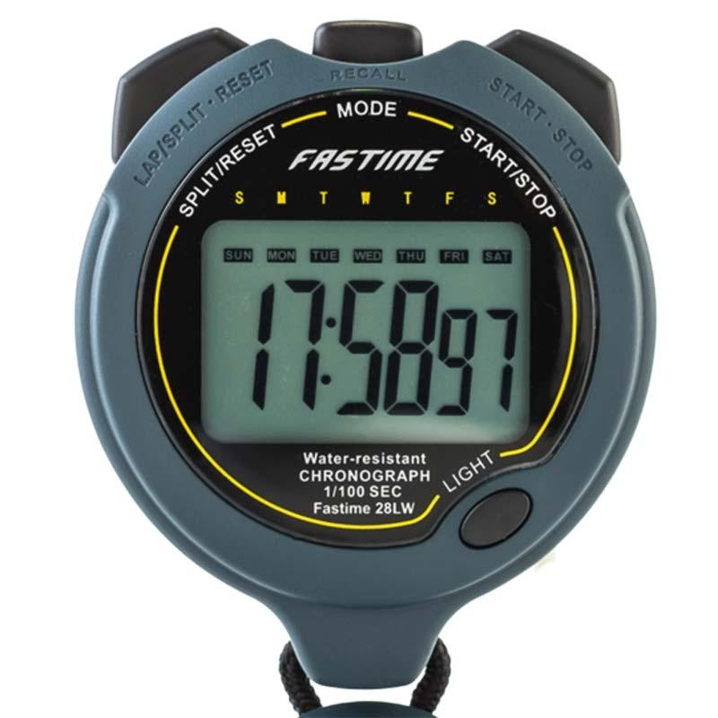
Self Reading: Quality Attributes- Performance, Scalability and Security

Slide 47
Performance
Ability to meet timing requirements.
Characterize pattern of input events and responses
Requests served per minute.
Variation in output time.
Driving factor in software design.
Often at expense of other quality attributes.
All systems have performance requirements.

Slide 48
Performance Measurements
Latency: The time between the arrival of the stimulus and the system’s response to it.
Response Jitter: The allowable variation in latency.
Throughput: Usually number of transactions the system can process in a unit of time.
Deadlines in processing: Points where processing must have reached a particular stage.
Number of events not processed because the system was too busy to respond.

Slide 49
Measurements - Latency
Time it takes to complete an interaction.
Responsiveness - how quickly system responds to routine tasks.
Key consideration: user productivity.
How responsive is the user’s device? The system?
Measured probabilistically (... 95% of the time)
“Under load of 350 updates per minute, 90% of ‘open account’ requests should complete within 10 seconds.”

Slide 50
Measurements - Latency
Turnaround time = time to complete larger tasks.
Can task be completed in available time?
Impact on system while running?
Can partial results be produced?
Ex: “With daily throughput of 850,000 requests, process should take < 4 hours, including writing to a database.”
Ex: “It must be possible to resynchronize monitoring stations and reset database within 5 minutes.”

Slide 51
Measurements - Response Jitter
Response time is non-deterministic.
If non-determinism can be controlled, this is OK.
10s +- 1s, great!
10s +- 10 minutes, bad!
Defines how much variation is allowed.
Places boundaries on when task can be completed.
If boundaries violated, quality is compromised.
Ex: “All writes to the database must be completed within 120 to 150 ms.”

Slide 52
Measurements - Throughput
The workload a system can handle in a time period.
Shorter the processing time, higher the throughput.
As load increases (and throughput rises), response time for individual transactions tends to increase.
With 10 concurrent users, request takes 2s.
With 100 users, request takes 4s.

Slide 53
Measurements - Throughput
Possible to end up in situation where throughput goals conflict with response time goals.
With 10 users, each can perform 20 request per minute (throughput: 200/m).
With 100 users, each can perform 12 per minute (throughput is higher - 1200/m - but at cost to response time for individual user).

Slide 54
Measurements - Deadlines
Some tasks must take place as scheduled.
If times are missed, the system will fail.
In a car, fuel must ignite when cylinder is in position.
Places a deadline on when the fuel must ignite.
Deadlines can be used to place boundaries on when events must complete.

Slide 55
Measurements - Missed Events
If the system is busy, input may be ignored.
Or, queued until too late to matter.
Can track how many input events are ignored because the system is too slow to respond.
Set upper bound on how many events can be missed in a defined timeframe.

Slide 56
Scalability
Ability to process increasing number of requests.
Horizontal scalability (“scaling out”)
Adding more resources to logical units.
Adding another server to a cluster.
“elasticity” (add or remove VMs from a pool)
Vertical scalability (“scaling up”)
Adding more resources to a physical unit.
Adding memory to a single computer.

Slide 57
Scalability
How can we effectively utilize additional resources?
Requires that additional resources:
Result in performance improvement.
Did not require undue effort to add.
Did not disrupt operations.
The system must be designed to scale
(i.e., designed for concurrency).

Slide 58
Assessing Scalability
Ability to address more requests is often part of
performance assessment.
Assessing scalability directly measures impact of adding or removing resources.
Response measures reflect:
Changes to performance.
Changes to availability.
Load assigned to existing and new resources.

Slide 59

Quality Attribute: Security

Slide 60
Security
Ability to protect data and information from unauthorized access...
… while still providing access to people and systems that are authorized.
Can we protect software from attacks?
Unauthorized access attempts.
Attempts to deny service to legitimate users.

Slide 61
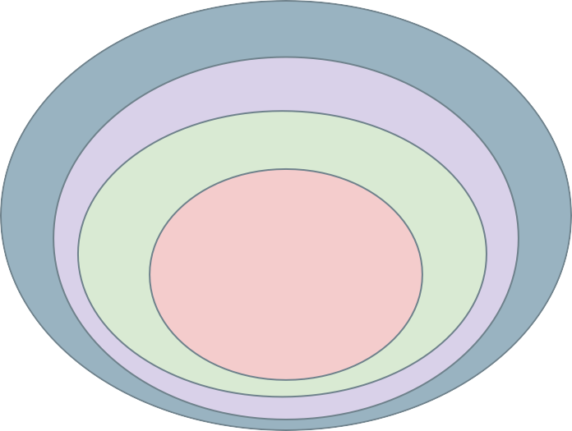
Security
Processes allow owners of resources to control access.
Actors
Actors are systems or users.
Resources are sensitive elements, operations, and data of the system.
Policies define legitimate access to resources.
Mechanisms Policies
Resources
Enforced by security mechanisms used by actors to access resources.

Slide 62
Security Characterization (CIA)
Confidentiality
Data and services protected from unauthorized access.
A hacker cannot access your tax returns on an IRS server.
Integrity
Data/services not subject to unauthorized manipulation.
Your grade has not changed since assigned.
Availability
The system will be available for legitimate use.
A DDOS attack will not prevent your purchase.

Slide 63






Supporting CIA
Authentication - Verifies identities of all parties.
Nonrepudiation - Guarantees that sender cannot deny sending, and recipient cannot deny receiving.
Authorization - Grants privilege of performing a task.

Slide 64
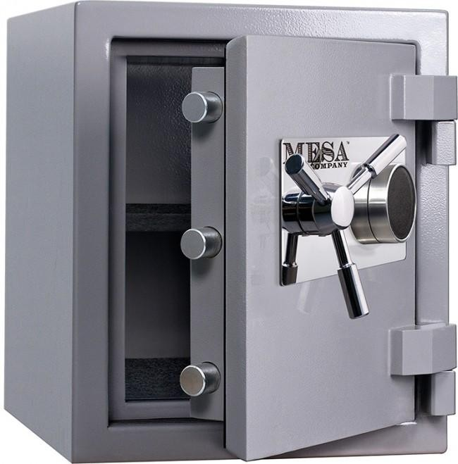
Security Approaches
Achieving security relies on:
Detecting attacks.
Resisting attacks.
Reacting to attacks.
Recovering from attacks.
Objects being protected are:
Data at rest.
Data in transit.
Computational processes.

Slide 65
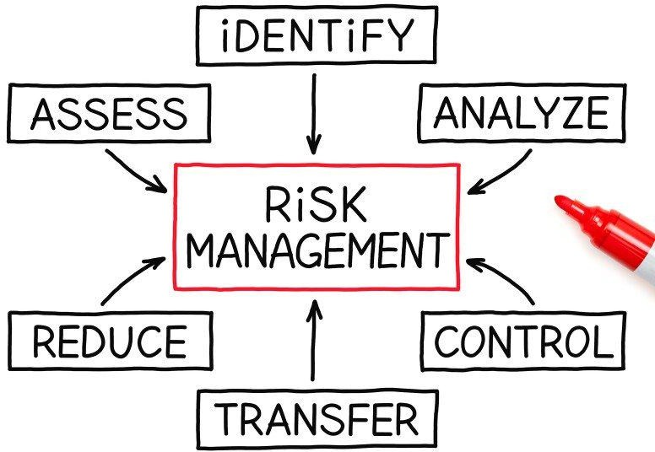
Security is Risk Management
Not simply secure/not secure.
All systems will be compromised.
Try to avoid attack, prevent damage, and quickly recover.
Balance risks against cost of guarding against them.
Set realistic expectations!

Slide 66
Assessing Security
Measure of system’s ability to protect data from unauthorized access while still providing service to authorized users.
Assess how well system responds to attack.
Stimuli are attacks from external systems/users or demonstrations of policies (log-in, authorization).
Responses: auditing, logging, reporting, analyzing.

Slide 67
Assessing Security
No universal metrics for measuring “security”.
Present specific attack types and specify how system responds.
Response assessed by appropriate metrics.
Time to identify attacker.
Amount of data protected.
Time to stop attack.

Slide 68
Next Time
More introduction:
Testing fundamentals.
Principles of analysis and testing.
Reading:
Chapters 1-4 of testbook.

